Slide 1

Let’s Make A Movie!
Juico Bowley

Slide 2
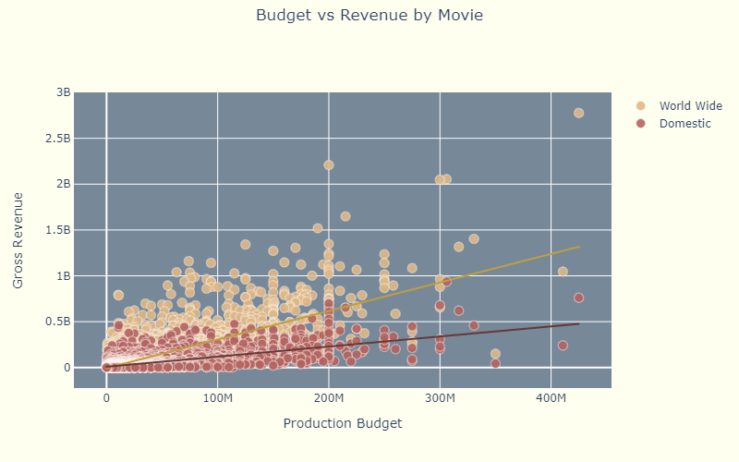
Most Profitable Movies
Avatar
Titanic
Star Wars Ep. VII
Bigger budget translates to bigger profits

Slide 3
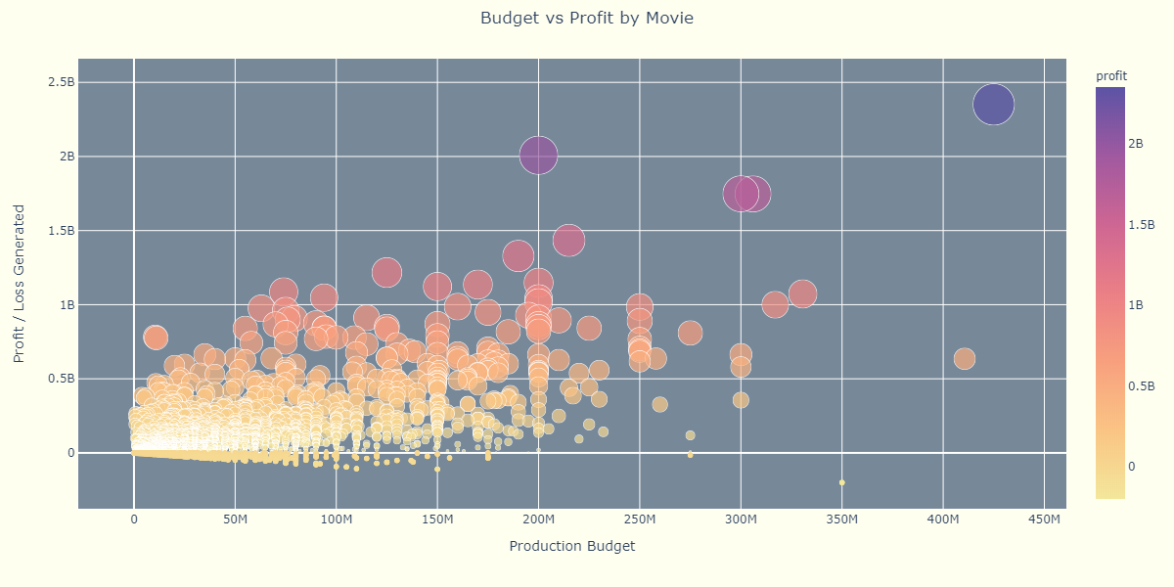
Most Profitable Movies
Avengers: Infinity War
Harry Potter and the Deathly Hallows Pt. 2
Furious 7
Jurassic World
Dark Phoenix

Slide 4
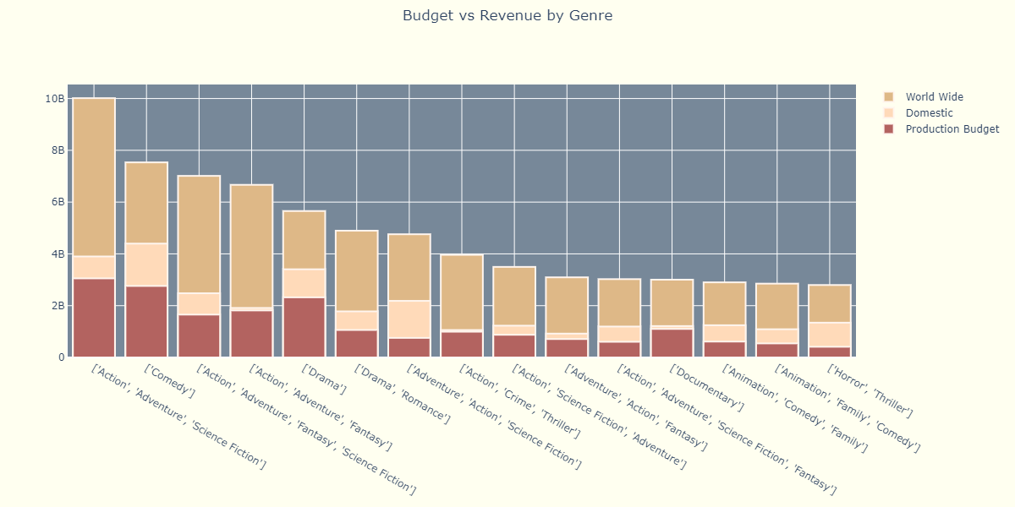
Most Profitable Genre Groups

Slide 5
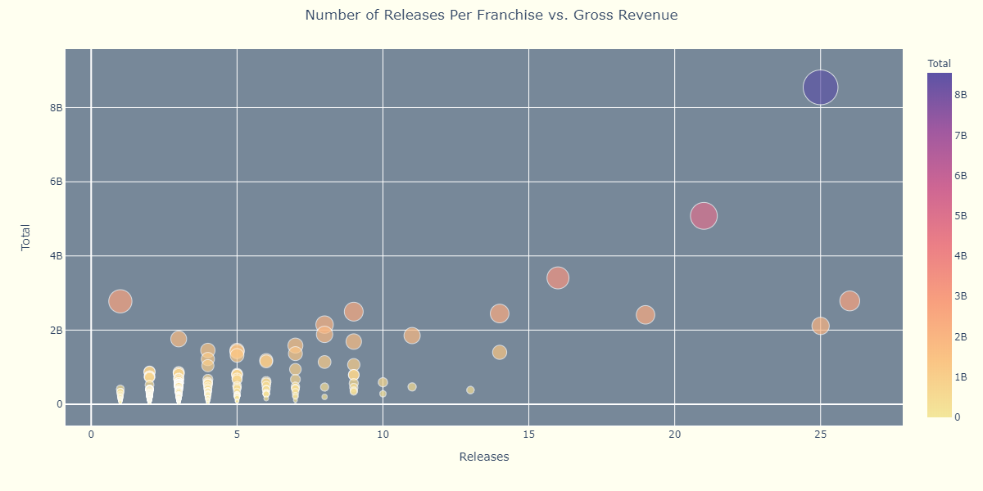
Most Profitable Franchises
Marvel Cinematic Universe
Star Wars
Disney Live Action Reimaginings
Avatar
J.K. Rowling’s Wizarding World
James Bond

Slide 6
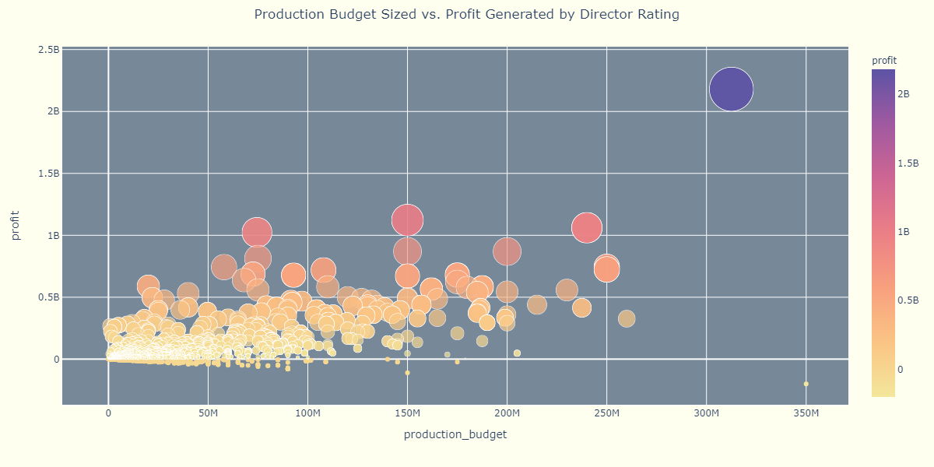
Most Profitable Director
James Cameron: Avatar
Pierre Coffin:
Minions
Chris Buck
Frozen
Anthony Russo: Captain America
Simon Kinberg:
Dark Phoenix

Slide 7
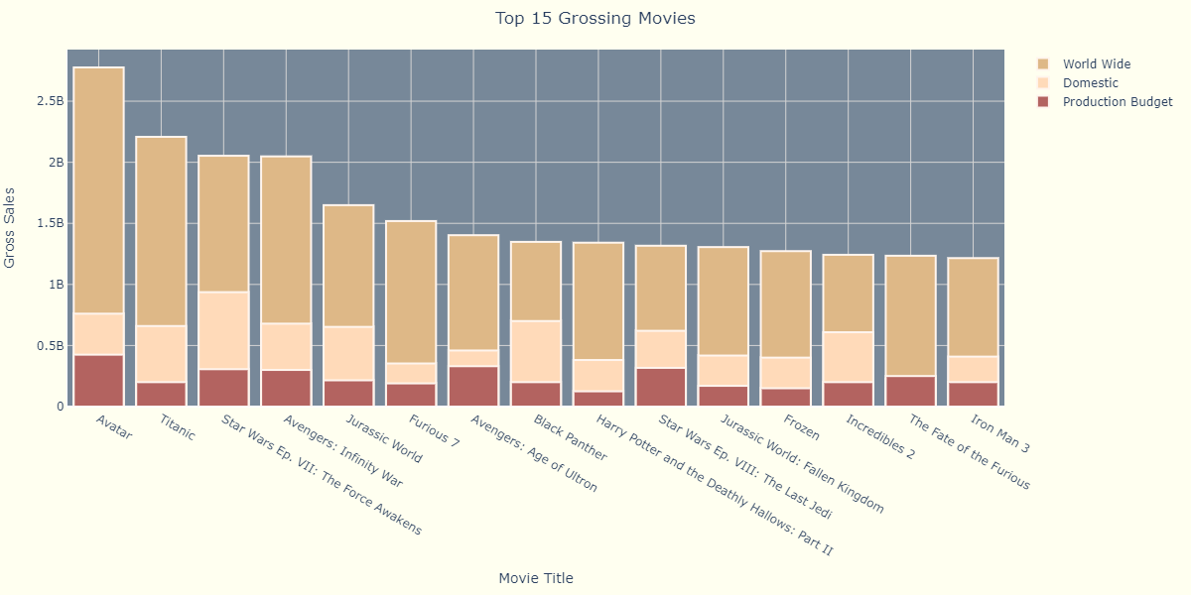
Putting It Together
Action, Adventure, Sci-Fi, Fantasy
J.J. Abrams
Franchise
Franchise
James Cameron
Franchise
Action, Adventure, Fantasy, Sci-Fi
James Cameron
Franchise

Slide 8

Thank You!

